Slide 1
Job Interview
Presented By : Najwa Mohammed

Slide 2
Table of contents
01
02
03
About me
Introduction
Algorithm
06
05
04
Relationship between Programming Paradigms
Programming
Pardigms
How do Computers Understand programming?

Slide 3
01
About Me
My name is Najwa Mohammed I'm 20 years old and I live in Ajman, U.A.E .
Profile
I have two years of work experience. I worked at Al Dar Academy for Vocational Education.
Experience
I have Pearson BTEC 5 Higher National Diploma.
Education
I worked out how programming works and created code.
Achievements

Slide 4

Introduction
02

Slide 5
Algorithm
03
01
About the scientist
02
Algorithm definition
03
Features of an algorithm
04
Algorithm Vs Program
05
Flowchart
06
Characteristics of an Algorithm
07
Types of Algorithms
08
Process of translation

Slide 6

About the scientist
The algorithm was named after the scientist Abu Jaafar Muhammad bin Musa Al-Khwarizmi, who invented it in the ninth century AD.

Slide 7
What is an Algorithm
An algorithm is a set of step-by-step procedures, or a set of rules to follow, for completing a specific task or solving a particular problem. Algorithms are all around us. The recipe for baking a cake, the method we use to solve a long division problem, and the process of doing laundry are all examples of an algorithm.

Slide 8
What is
An algorithm is a step-by-step process for solving a particular problem.
In computer science, a problem is a task or a question that needs to be solved or answered.
an Algorithm
a Problem
a problem is a general task or question that needs to be solved, while an algorithm is a specific solution or method to solve that problem.

Slide 9
5 features of an algorithm
01
The expected inputs of an algorithm must be well-defined to ensure its correctness, predictability, and repeatability.
It ensure that the algorithm's behavior is deterministic, which means, that the same input will always produce the same output.
well-defined inputs
well-defined outputs
02
The outputs of an algorithm should be well-defined to ensure that the algorithm produces the intended and accurate result for a given set of inputs.
Unambiguity
03
Ambiguity in the algorithm's description can lead to incorrect implementations and unreliable results. That is why it is important for an algorithm to be unambiguous.
Finiteness
04
The algorithm should end after a finite amount of time, and it should have a limited number of instructions.
Effectiveness and Feasibility
05
An algorithm should be feasible because feasibility indicates that it is practical and capable of being executed within reasonable constraints and resources.

Slide 10
Algorithm Vs Program
Algorithm is a step by step logical approach and program is a set of instructions for a given task.
It is a well-defined, step-by-step, logical procedure for solving a given problem.
01
It refers to a set of instructions for a computer to follow. A program can implement many algorithms, or a program can even contain no algorithms.
An algorithm provides abstract steps for processing one sequence of related information into a different sequence of derived information.
02
The constituents of a program may not be conceptually related.
It is written using plain English language and can be understood by those from a non-programming background.
03
It could be written in any programming language, such as Python, Java, C++, or any other language, depending on the particular task the program is designed for.
It can be expressed in natural language, flow charts, pseudocode, and various programming languages.
04
We write computer programs in a computer language. Then a compiler or interpreter translates it into a language that any computer system understands.
An algorithm can be executed by a person.
05
A program is always executed by a computer.

Slide 11
What is a flowchart?
flowchart is a graphical representation that uses symbols and lines to illustrate the sequence of steps, decisions, and actions within a process, making it easier to understand and communicate complex algorithms.
Symbol | Name/Function | Symbol | Name/Function
 | Action or Process A box can represent a single step ("add two cups of flour"), or an entire sub-process ("make bread") within a larger process. |  | Start/End The terminator symbol marks the starting or ending point of the system. It usually contains the word "Start" or "End."
 | Input/Output Represents material or information entering or leaving the system, such as customer order (input) or a product (output). |  | Connector Indicates that the flow continues where a matching symbol (containing the same letter) has been placed.
 | Decision A decision or branching point. Lines representing different decisions emerge from different points of the diamond. |  | Arrows A line is a connector that shows relationships between the representative shapes.

Slide 12
Characteristics of Algorithms
Input
Finiteness
An algorithm can be given a
value other than 0 as input.
The algorithm should have a
limited number of instructions.
Output
Effectiveness
At the end of an algorithm, you
will have one or more outcomes.
The overall process, it should
be adequate.
Unambiguity
independence
Instructions should be clear
and straightforward.
Instructions can be implemented
in any language and produce
the same results.

Slide 13



Types of Algorithms
These algorithms are used to sort the data in a particular format.
These algorithms are used in finding a value or record that the user demands.
It is used to find solutions to problems like finding the shortest path between cities.
Sorting
algorithms
Searching
algorithms
Graph
Algorithms

Slide 14
01
Bubble Sort
is the simplest sorting algorithm that works by
repeatedly swapping the adjacent elements if they
are in the wrong order.
Sorting Algorithms
Sorting is arranging a group of data in a particular manner according to the requirement.
02
Selection Sort
is a simple and efficient sorting algorithm that works by repeatedly selecting the smallest (or largest) element from the unsorted portion of the list and moving it to the sorted portion of the list.

Slide 15

Algorithm of Bubble Sort
Step1: Take first two element and check, if the
first element is bigger than the second element
swap, if it’s not bigger stop and don’t swap.
Step2: Take the second element and the third
element and check, if the second element is
bigger than the third element swap, if it’s not
bigger stop and don’t swap.
Step4: Repeat the process until the array is
sorted.

Slide 16
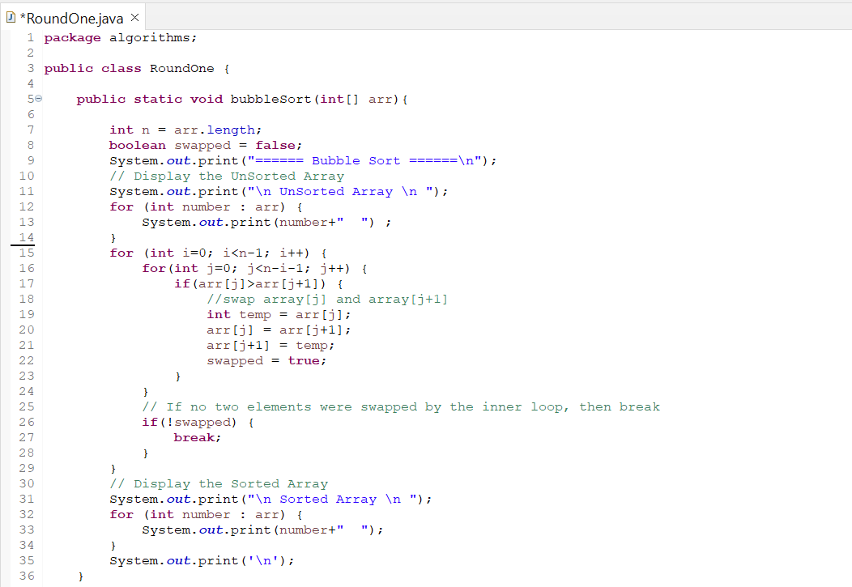
Bubble Sort method

Slide 17
Algorithm of Selection Sort
Step1: Take the first element and then check if it’s
smallest element or not by comparing it with all
the other elements.
Step2: If there is another element found smaller
than the first element, Swap the first element with
the smallest element.
Step5: Repeat the process until the array is
sorted.

Slide 18
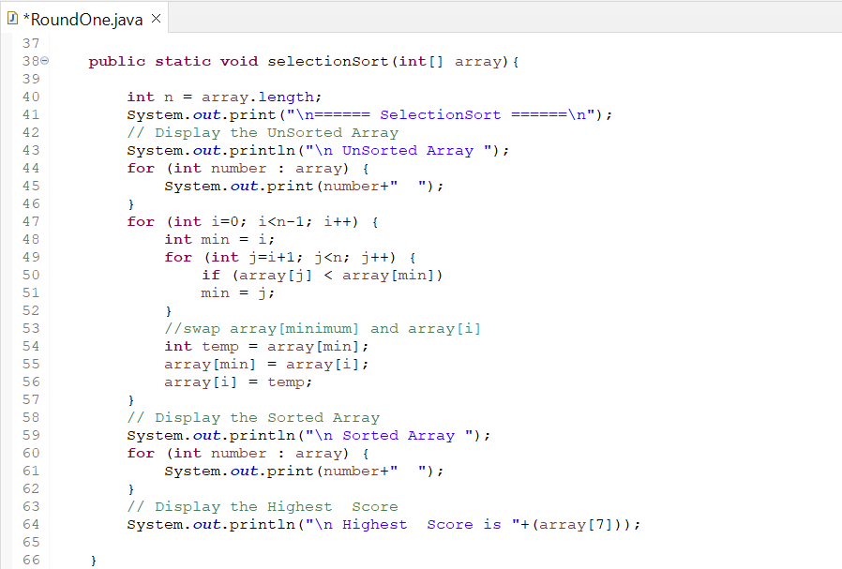
Selection Sort method

Slide 19
01
Linear Search
is defined as a sequential search algorithm that starts at one end and goes through each element of a list until the desired element is found, otherwise the search continues till the end of the data set.
Searching algorithms
Sorting is arranging a group of data in a particular manner according to the requirement.

Slide 20

Algorithm of Linear Search
Step1: Take the search element in the array.
Step2: Check each element in the list sequentially
until a match is found or the whole list has been
searched.
Step3: If the key is found, it means the element
are existed and the loop will stop.
Step4: If the key is not found, it means that the
element are never existed.

Slide 21
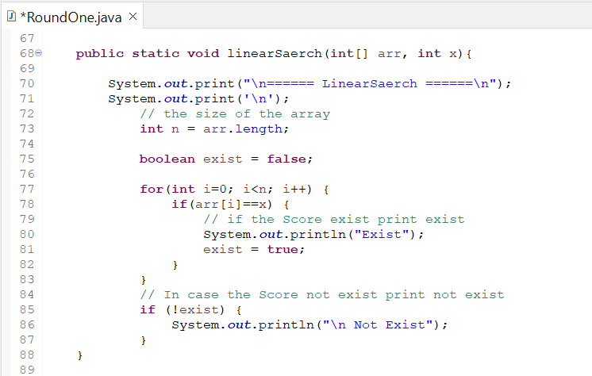
Linear Search method

Slide 22
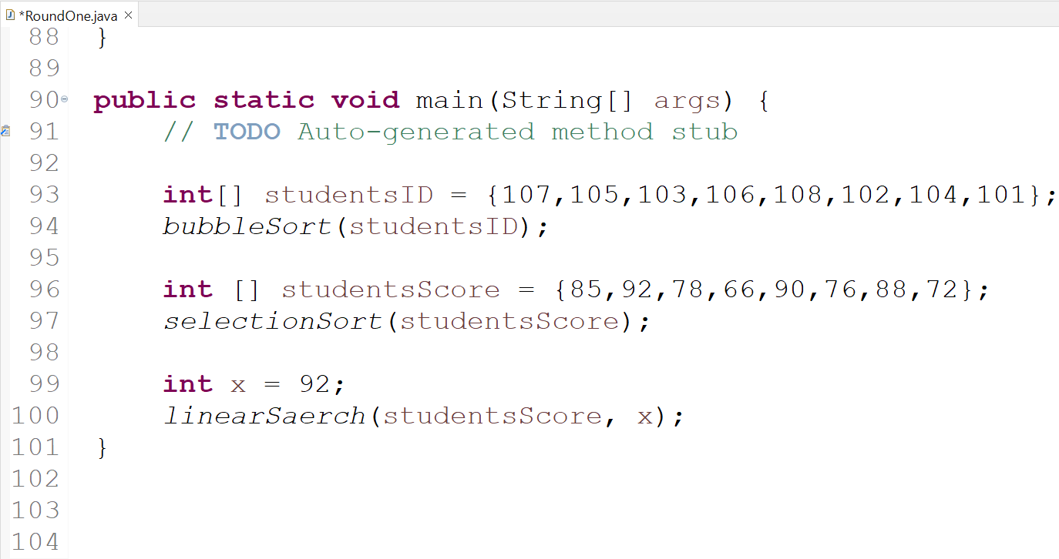

Main method

Slide 23
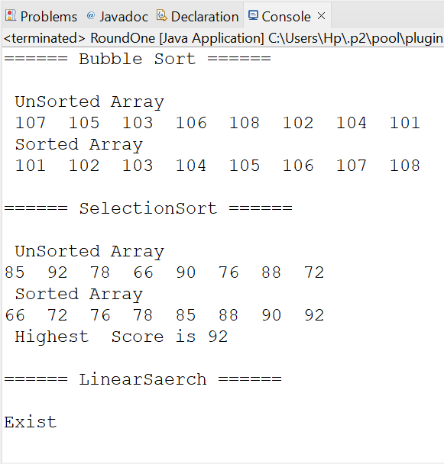

Execution

Slide 24
Challenges that I faced
I faced many challenges, but I was able to overcome them with determination and trying over and over again. I will tell you some of them. first I will tell you about the simple challenges, then the ones that were more difficult for me.
The simplest challenge I faced was that the yellow line appeared in the Main method code because I didn't use the value. I solved the problem by deleting the value because I will not use it.
I also faced a compile-time error because I forgot a semicolon at the end of one of the lines of code.
I faced the same problem again because I forgot to close the bracket at the end of the code.
And than I faced another challenge because I didn't pay attention to my spelling when i was writing the word (array) correctly more than once for that reason I had to spell all the words again, that was a difficult challenge but I passed it too.

Slide 25
How do Computers Understand programming?
04
➔ Computers understand programming
through a process of translation.
➔ Programming languages are designed for
human readability and understanding.
➔ When you write code in a programming
language like Java or Python, a
translator (compiler or interpreter)
converts that code into
machine-readable instructions, which
the computer's hardware can execute
directly.

Slide 26
process of translation
01
Interpreter
03
Assembler
Interpreter is a program that converts the high level language into the bit format i.e. machine language. The function of the interpreter and compiler is the same but the interpreter translates one line at a time and executes it. No object code is produced so every time when the program has to be run it is to be interpreted first.
The assembler enters the arena after the compiler has played its part. The assembler translates our assembly code to the machine code and then stores the result in an object file. This file contains the binary representation of our program.
02
Compiler
04
Linker
A compiler is a specialized system tool that translates a program written in a specific programming language into the assembly language code.
Next, we move to the linker module. The linker spawns to action after the assembler has done its job. The linker combines all external programs (such as libraries and other shared components) with our program to create a final executable. At the end of the linking step, we get the executable for our program.

Slide 27
05
Programming Paradigms
Programming Paradigm Defined
A programming paradigm is the classification, style or way of programming. It is an approach to solve problems by using programming languages. Depending on the language, the difficulty of using a paradigm differs.

Slide 28
Types of Programming Paradigms
Procedural programming paradigm
01
Procedural programming is a programming paradigm, derived from imperative programming, based on the concept of the procedure call. Procedures (a type of routine or subroutine) simply contain a series of computational steps to be carried out.
Object oriented Programming
02
Object-oriented programming (OOP) is a programming paradigm based on the concept of objects, which can contain data and code: data in the form of fields (often known as attributes or properties), and code in the form of procedures (often known as methods).
Event-driven programming
03
Event-driven programming is the dominant paradigm used in graphical user interfaces applications and network servers. In an event-driven application, there is generally an event loop that listens for events and then triggers a callback function when one of those events is detected.

Slide 29
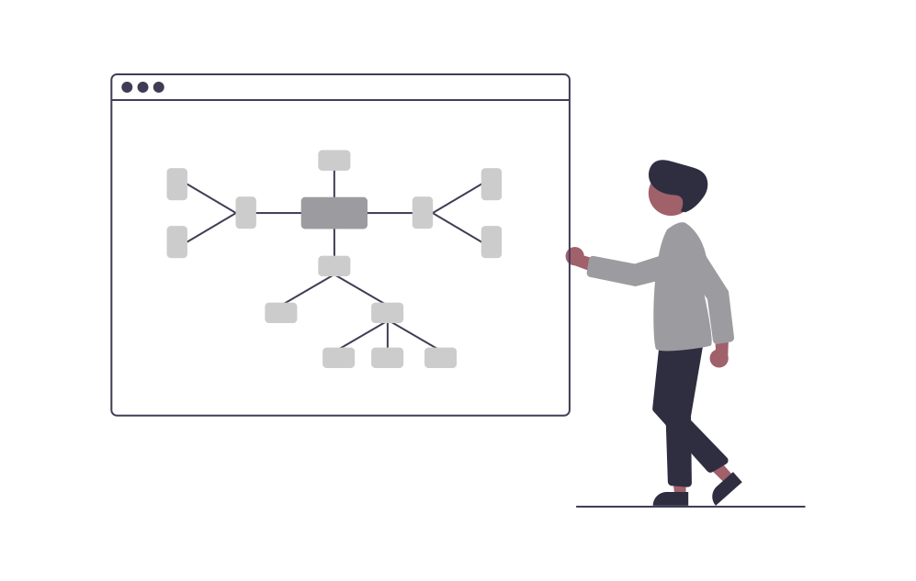
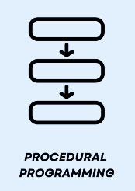
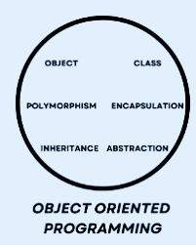
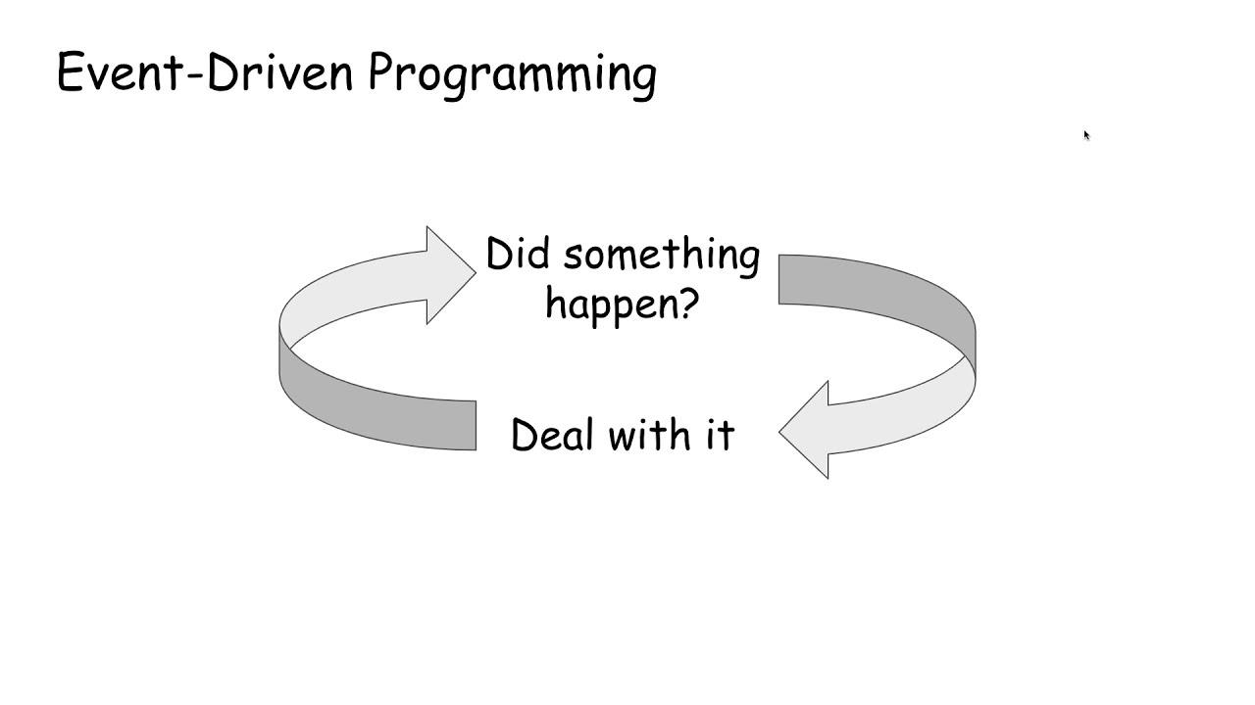
Relationship between Programming Paradigms
06
Each paradigm consists of certain structures, features, and opinions about how common programming problems should be tackled. The question of why are there many different programming paradigms is similar to why are there many programming languages.
Procedural programming
object-oriented programming
event driven programming
Procedural programming divides many functions to solve problem.
Object oriented programming divides program into multiple objects.
event-driven programming is a programming paradigm in which the flow of the program is determined by external events.

Slide 30
Relationship between Procedural programming and object-oriented programming
relationship
Procedural Programming, which at times has been referred to as inline programming, takes a more top-down approach to programming. Object-oriented Programming uses classes and objects, Procedural Programming takes on applications by solving problems from the top of the code down to the bottom.
Procedural Programming divides the program into small programs and refers to them as functions. Object Oriented Programming divides the program into small parts and refers to them as objects. Available data is capable of moving freely within the system from one function to another.
Procedural uses functions and languages like C++ which also used in object-oriented programming. And in event driven programming it uses event such as notification, messages and outcome which is also similar in object oriented and procedural programming. And they all use loops, data types and structures.

Slide 31
Relationship between event driven programming and object-oriented programming
relationship
Object Oriented Programming (OOP) and Event-Driven Programming (EDP) are orthogonal, which means that they can be used together. In OOP with EDP all OOP principles (encapsulation, inheritance and polymorphism) stay intact.
In OOP with EDP objects acquire some mechanism of publishing event notifications and subscribing to event notifications from other objects. In OOP without EDP control moves from one object to another object on a method call. Object mainly invokes methods of other objects.
In OOP with EDP control moves from one object to another object on event notification. Object subscribes on notifications from other objects, then waits for notifications from the objects it is subscribed on, does some work based on notification and publishes it's own notifications.

Slide 32
Thanks!
Do you have any questions?
najwamohammed1510gmail.com

